Slide 1

Introduction
Why does sleep matter?
The Problem
Many struggle to get enough sleep.
Lack of understanding about what shapes sleep duration.
Our Focus
Does age affect sleep duration?
Our Hypothesis
Age has no effect on sleep duration.
Our Motivation
Inform healthcare strategies and policies to prevent sleep related health issues.

Slide 2
The Data
Source:
CDC National Health & Nutrition Examination Survey (NHANES)
Dependent
Independent
Sleep (Hours)
Age (Years)
Gender (M/F)
Income (Income/Poverty ratio)
Moderate Exercise/week (Minutes)
Vigorous Exercise/week (Minutes)
Notes:
This analysis uses data from the CDC National Health & Nutrition Examination Survey (NHANES), a comprehensive program designed to assess the health and nutritional status of the U.S. population throughinterviews and physical examinations.

Slide 3
Data Wrangling
Column Selection:
SEQN: Unique ID for each respondent
Sleep Duration: Hours of weekday sleep.
Age: Respondent age in years.
Gender: Binary variable for gender.
Poverty Index: Income-to-poverty ratio.
Frequency of Moderate and Vigorous Leisure-Time Physical Activity (LTPA)
Minute of Moderate and Vigorous LTPA
Variable Creation:
Total Moderate Activity: Minutes of moderate activity per week.
Total Vigorous Activity: Minutes of vigorous activity per week.
Total Physical Activity: Sum of moderate + vigorous activity per week
Data Cleaning:
Excluded rows with missing values.
Dropped redundant variables after Total_Week_LTPA creation.
Final Dataset contained 2,991 observations

Slide 4
Creating the Models
Simple Model: Sleep ~ Age + Gender + Poverty_Index
Complex Model: Sleep ~ Age + Gender + Poverty Index + Physical Activity
Notes:
These are the features we will be including in our models:
These are variables we thought would have an impact on sleep so throughout the next few slides, we will be assessing how well or not well these variables do affect sleep.

Slide 5
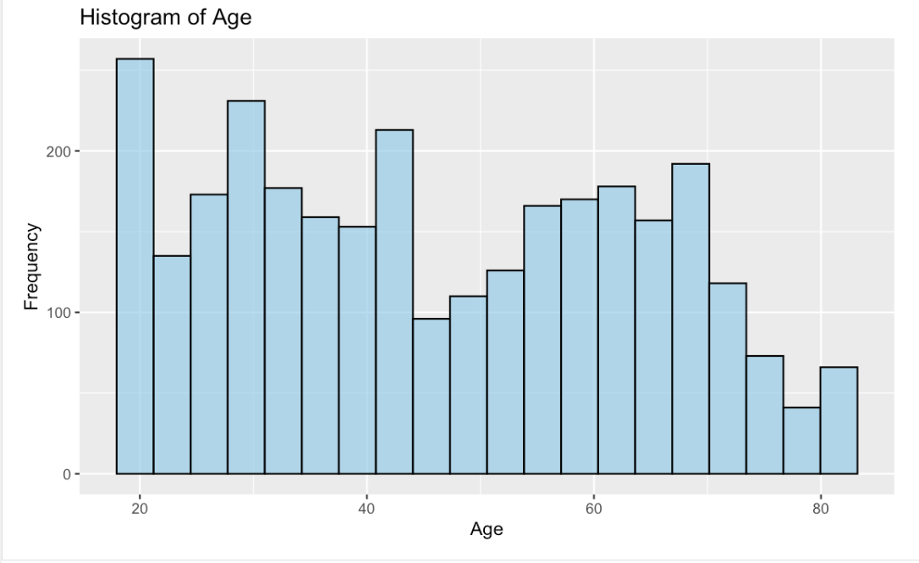
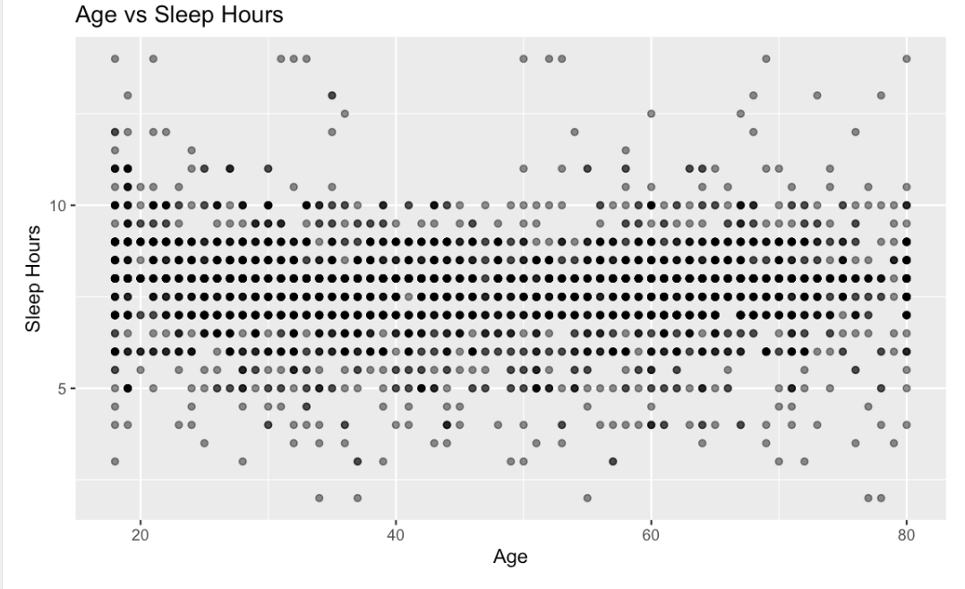
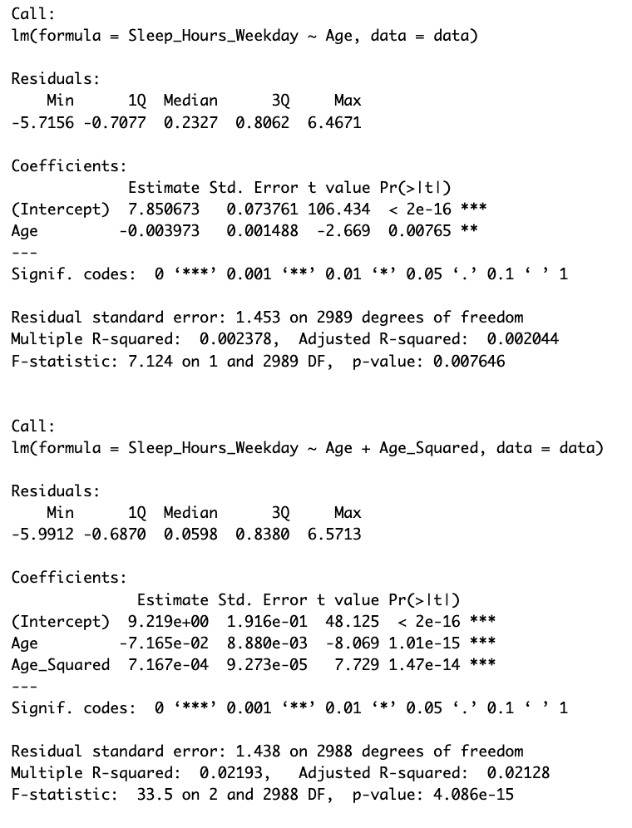
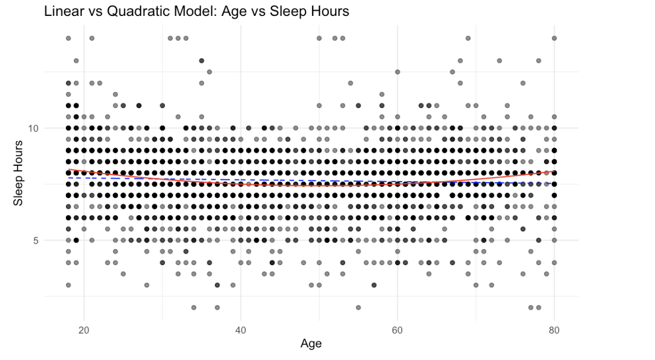
Assessing the Simple Model Features: Age
Summaries of both models:
Age vs. Sleep
Sleep ~ Age is not linear, plot showcases potential for quadratic model
Explore quadratic transformation: Sleep ~ Age + Age^2
Notes:
First we will be analyzing the age feature in the model.
After plotting age against sleep, we see there is no obvious linear trend between age and sleep hours. However, the variation in sleep hours across age is fairly consistent, suggesting that age might have a weak or nonlinear effect on sleep duration.
We wanted to explore a quadratic transformation to capture any potential curved relationship.
The quadratic model better captures potential non-linear patterns in the data compared to the linear model.
However, the improvement is small (Adjusted R-squared increased from 0.002 to 0.021), suggesting that age still explains only a tiny portion of the variance in sleep hours but the quadratic model better fits the data but still has limited explanatory power.
We decided to still keep this variable in the model since we can add other variables (e.g., gender, poverty index) to improve the model's performance.

Slide 6
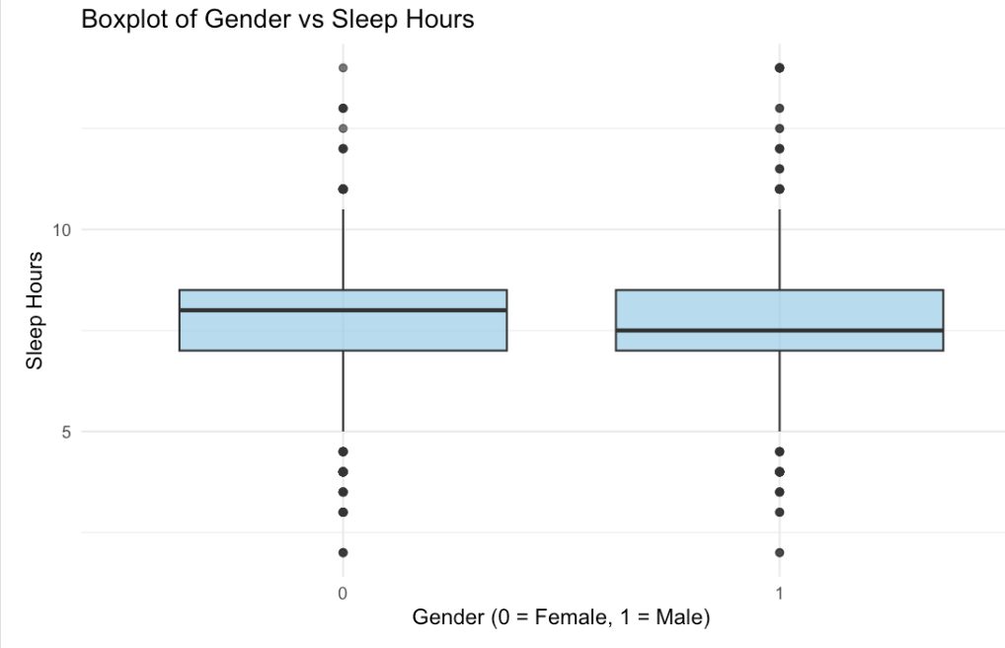
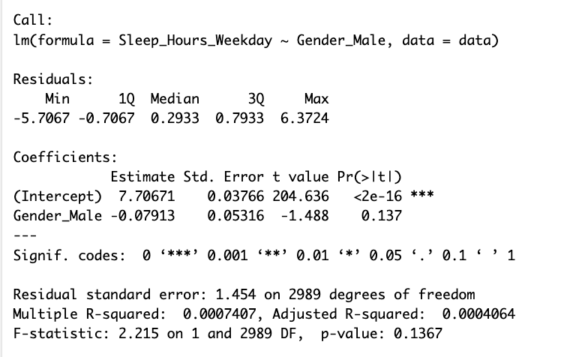
Assessing the Simple Model Features: Gender
Notes:
Next, we analyzed the gender variable.
Looking at the plots here, the median sleep hours for Males (Gender = 1) and Females (Gender = 0) appear very close, suggesting minimal differences.
The interquartile range (IQR) and spread of the data are also similar between the two genders, indicating that extreme sleep values are equally distributed.
Since Gender is categorical we will not apply transformations.
The p-value for the coefficient is 0.137, which is not statistically significant (p > 0.05). This means that the observed difference in sleep hours between Males and Females could easily be due to chance.
And the F-statistic p-value (0.1367): This suggests the overall model is not statistically significant, further confirming that Gender is not a strong predictor of Sleep Hours.
While Gender alone might not significantly predict Sleep Hours, its relationship could change when combined with other predictors (e.g., Gender might affect sleep differently depending on Age or Poverty Index).

Slide 7
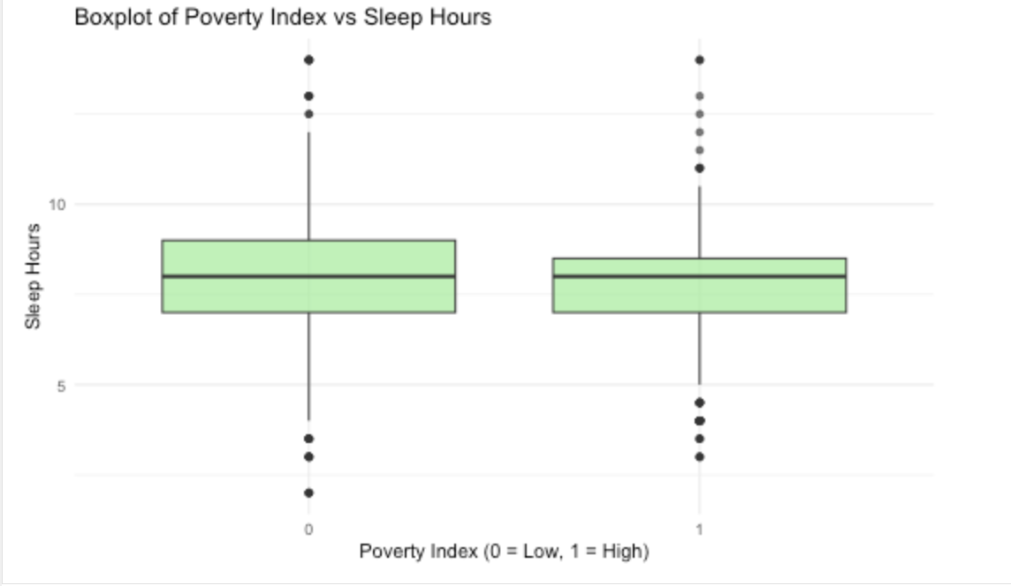
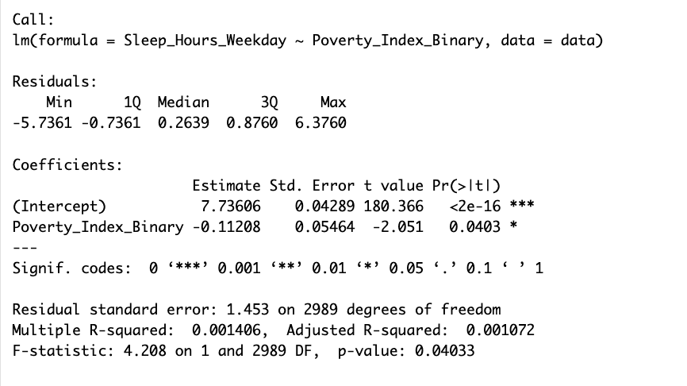
Assessing the Simple Model Features: Poverty Index
Notes:
Lastly we analyzed the Poverty Index dummy variable.
The interquartile range (IQR) and spread of sleep hours are very similar across the two groups, with no dramatic differences in variability.
This suggests a potential small difference in sleep hours based on the Poverty Index.
The p-value for the Poverty_index_binary coefficient is 0.0403, which is statistically significant (p < 0.05). This suggests that the difference in sleep hours is unlikely to be due to random chance, although the effect size is very small.
The Adjusted R-squared is extremely low suggesting that while the difference between the groups is statistically significant, the Poverty Index is not a strong predictor of Sleep Hours.
The overall model is statistically significant, but as indicated by the low R-squared, the practical importance of the Poverty Index is still minimal.

Slide 8
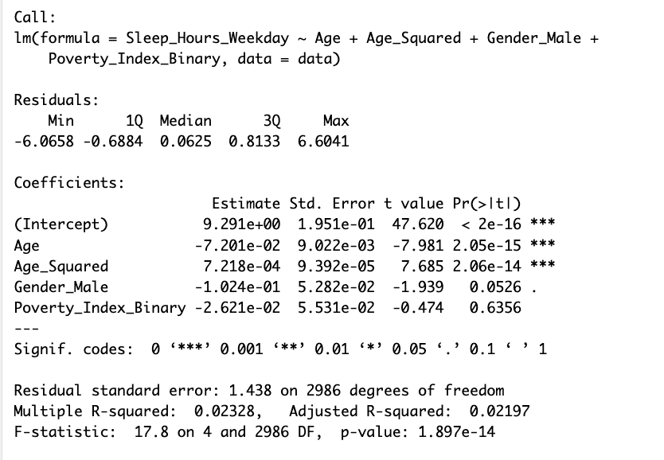
Evaluating the Full Simple Model
model_full <- Sleep_Hours_Weekday ~ Age + Age_Squared + Gender_Male + Poverty_Index_Binary
Notes:
This slide shows the regression summary taking into account all the features previously mentioned.
The model as a whole is statistically significant (p < 0.05), meaning that at least one of the predictors contributes significantly to the model.
The model indicates a weak overall fit but this is not surprising given the nature of the variables and the small effect sizes.
The coefficient for Age and Age^2 is highly significant, the Gender variable is marginially significant, and the poverty index suggests no meaninful impact.
—-------------
indicates that as Age increases by one year, Sleep Hours decrease by 0.072 hours, assuming all other variables are held constant.
p-value < 0.001: Highly significant.
Age_Squared (7.218e-04):
Suggests a slight curvature in the relationship between Age and Sleep Hours. As Age increases, the decline in Sleep Hours slows down (non-linear effect).
p-value < 0.001: Highly significant.
Gender_Male (2.042e-01):
Indicates that Males (Gender_Male = 1) sleep 0.204 hours more than Females, assuming other variables are constant.
p-value = 0.0526: Marginally significant (slightly above the standard 0.05 threshold).
Poverty_Index_Binary (-2.612e-02):
Individuals with a High Poverty Index (Poverty_Index_Binary = 1) sleep 0.026 hours less than those with a Low Poverty Index.
p-value = 0.6356: Not statistically significant, suggesting no meaningful impact.

Slide 9
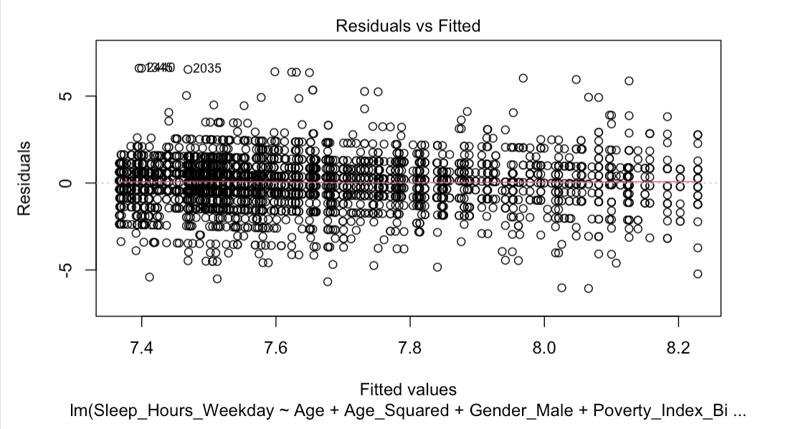
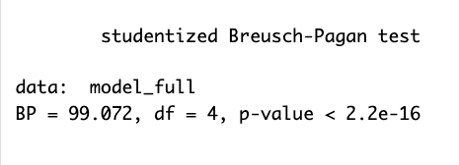
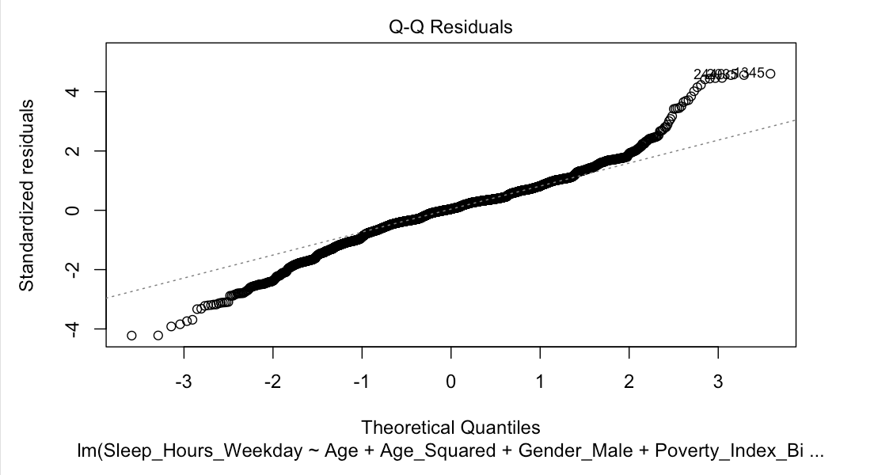
Assumptions for Simple Model
1. Linearity: Residual vs Fitted Plot. 2. Homoskedasticity: Breusch-Pagan test.
3. Normality: Q-Q plot and Shapiro-Wilk test. 4. Multicollinearity: Variance Inflation Factor (VIF)
Notes:
We also checked all the assumptions which I will briefly go over.
The linearity assumption appears to be satisfied - however, there is some variability in the residual spread, which we will check further for homoscedasticity.
The residuals are heteroskedastic, meaning that the variance of the residuals is not constant.
The Q-Q plot shows deviations from the diagonal line at both tails, indicating that the residuals are not perfectly normally distributed which is a common issue in real-world data.
The VIF values for Age and Age_Squared are very high (~37), indicating severe multicollinearity between these two predictor as expected since they are mathematically related.
The VIF values for Gender_Male and Poverty_Index_Binary are low (< 2), suggesting no multicollinearity issues for these variables.
The high multicollinearity between Age and Age_Squared is expected, as they are mathematically related. This does not bias the model’s predictions but can make it difficult to interpret individual coefficients.

Slide 10
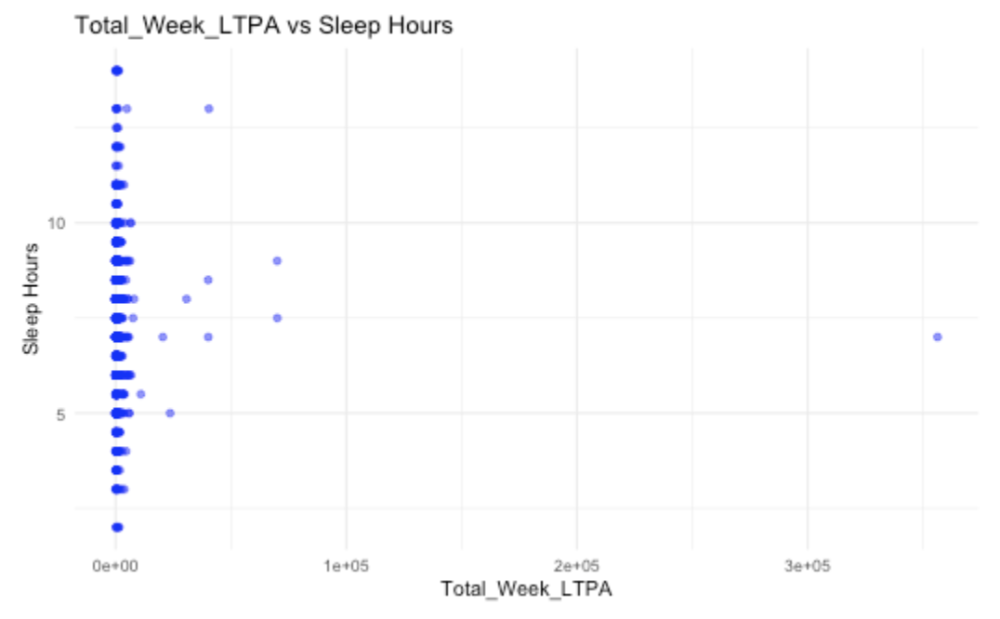
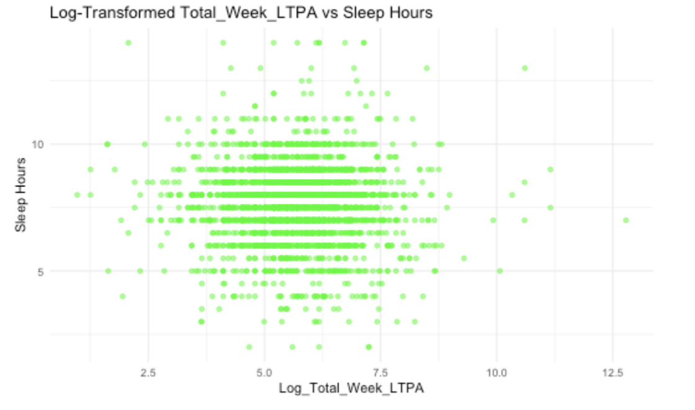
Expanding Model
Complex Model: model_full <- Sleep_Hours_Weekday ~ Age + Age_Squared + Gender_Male + Poverty_Index_Binary + Physical Activity
Log Transformation
Notes:
Next, for the complex model we expanded it to include the variable that accounts for physical activity during the week.
We applied a log transformation to the variable since it is highly skewed, with most data points clustered near 0 and a few extreme outliers with very high values.

Slide 11
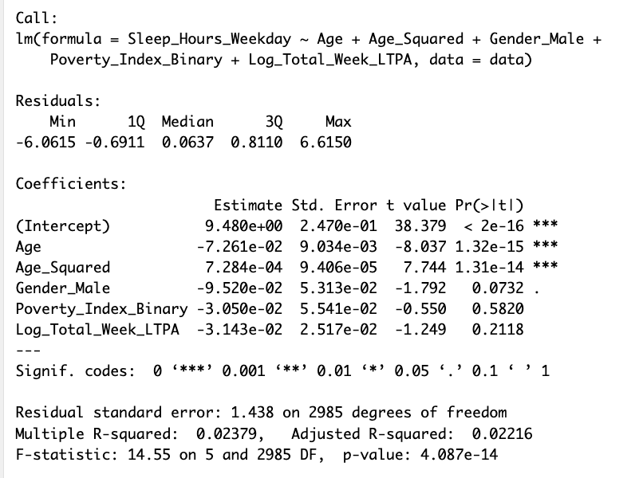
Evaluating the Full Complex Model
Notes:
The model as a whole is statistically significant, meaning at least one predictor contributes to explaining the variance in Sleep Hours.
The quadratic term captures the non-linear relationship between Age and Sleep Hours and it shows that Age is a strong predictor of Sleep Hours.
For every 1-year increase in Age, Sleep Hours decrease by approximately 0.072 hours, holding all other variables constant.
However, it seems as though Gender, poverty index, and physical activity may not have a significant impact on sleep hours

Slide 12
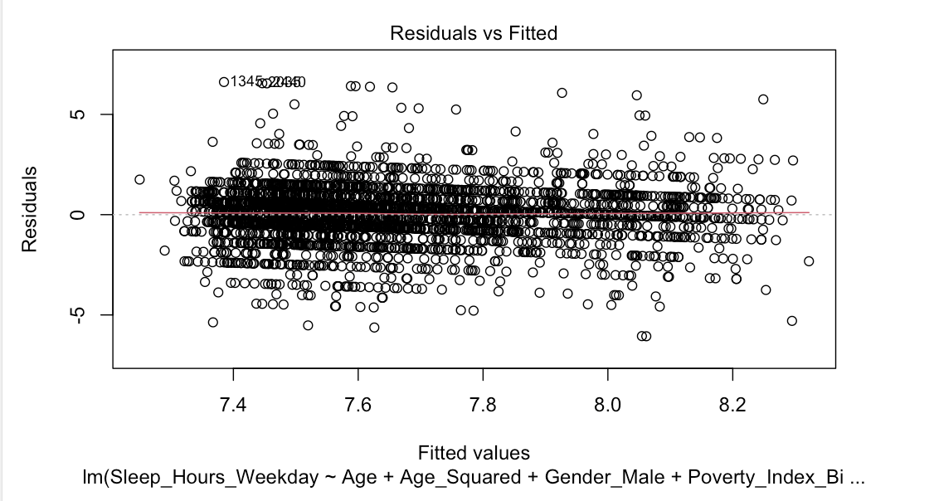
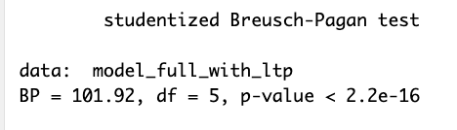
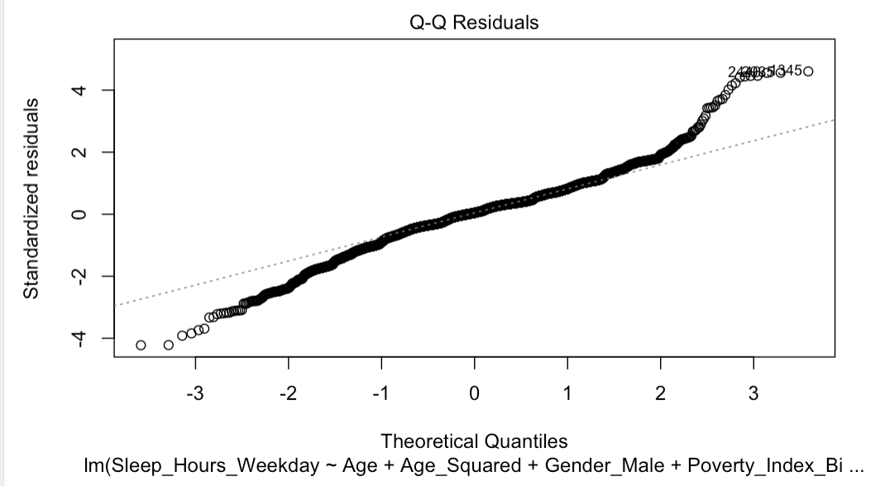
Assumptions for Complex Model
1. Linearity: Residual vs Fitted Plot. 2. Homoskedasticity: Breusch-Pagan test.
3. Normality: Q-Q plot and Shapiro-Wilk test. 4. Multicollinearity: Variance Inflation Factor (VIF)
Notes:
In summary, after assessing the assumptions for this model, it remains almost identical to the assumption plots of the previous model indicating that linearity is satisfied but the other assumptions are not quite met according to the various tests and plots.
—--
The spread of residuals across fitted values is fairly even, suggesting no strong non-linear trends.
The Breusch-Pagan test result is significant (BP = 101.92, p-value < 2.2e-16), indicating that the null hypothesis of constant variance is rejected.
The residuals are heteroskedastic, meaning the variance of residuals is not constant. This violation could affect the reliability of standard errors and p-values.
The Q-Q plot shows deviations from the diagonal line, especially at both tails, indicating that residuals are not perfectly normally distributed.
VIF for Age and Age_Squared remains high (~37), indicating strong multicollinearity between these terms.
VIF values for Gender_Male, Poverty_Index_Binary, and Log_Total_Week_LTPA are low (< 2), suggesting no multicollinearity issues for these predictors.

Slide 13
Recommendations for Improvement
Use robust standard errors to address heteroskedasticity
Reduce multicollinearity between Age and Age^2
Include interaction terms to capture more complex relationships or using other variables included in the dataset
Notes:
These are some action items we could take to improve our model

